Slide 1


Analysing Fuel Sources
A Comprehensive Study
Presented by: [Nikhila Reddy Vantari & Archana Gadicharla]
Fundamentals of Machine learning(Group-7)

Slide 2

Contents
Problem Statement
Data Overview – an overview about the data
Data Cleaning – dealing with irrelevant variables and missing values
Data Exploration – Basic Statistics
Feature Selection – ANOVA, correlation , PCA
Finding optimal k – Silhouette method
Model Developing – K-means and dbscan
Conclusion

Slide 3

Problem Statement
Optimization of Fuel Efficiency

Slide 4
Data Overview
The dataset comprises 38,113 observations and includes 81 variables. Among these variables, 17 are categorical, while the remaining 62 are numerical.
This problem involves clustering without a designated target variable.

Slide 5
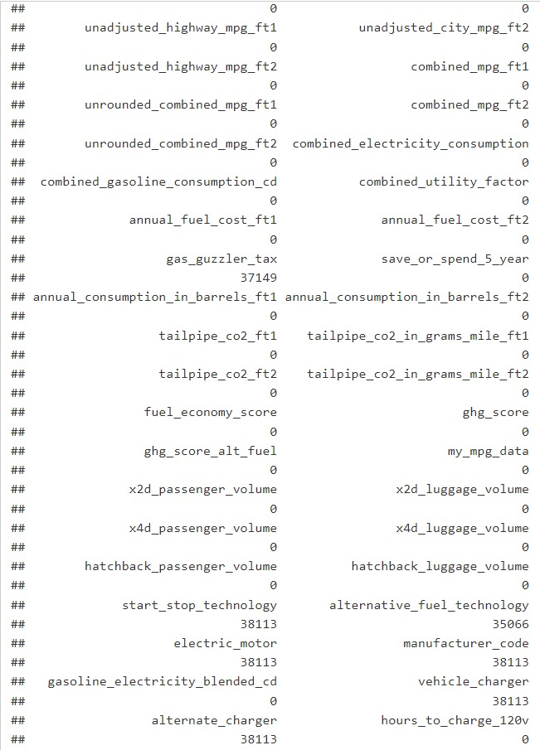
Data Cleaning
Eliminating Missing Values:
Among the 81 variables, 17 contain missing values. Since the percentage of missing values in each variable is below 5%, all missing values are removed from the dataset.
Removing irrelevant Variables:
Certain variables, such as "supercharger," "fuel_type_2," "start_stop_technology," "electric_motor," "manufacturer_code," "vehicle_charger," "alternate_charger," "range_ft2," and "vehicle id," are deemed irrelevant. Hence, these variables are excluded from the dataset.

Slide 6

Grouping into categories
Fuel economy variables
Emission Variables
Vehicle dimension Variables

Slide 7
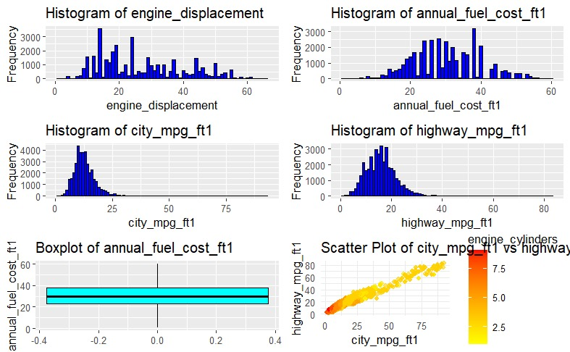
DATA EXPLORATION

Slide 8
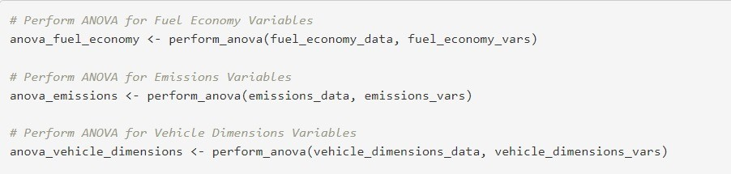
Feature Selection using ANOVA, Co-relation matrix, PCA.
ANOVA:
Performing ANOVA for three different categories which includes fuel_economy, emissions, vehicle_dimensions.
And filtering out non-significant variables at the significance level of 0.01.

Slide 9
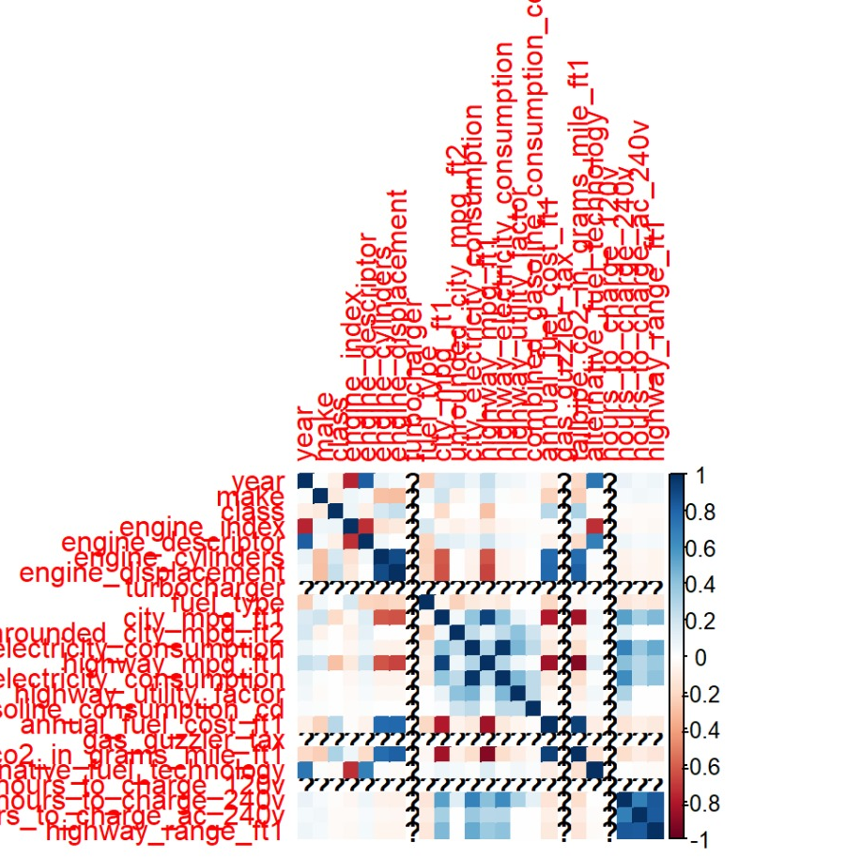
CO-RELATION MATRIX
The near zero variance features are founded and calculated the most frequent values, unique values and the second most frequent values.
Identified the columns with near zero variance and removed those columns.
And removed constant or near constant columns at the significance level of 0.01.

Slide 10
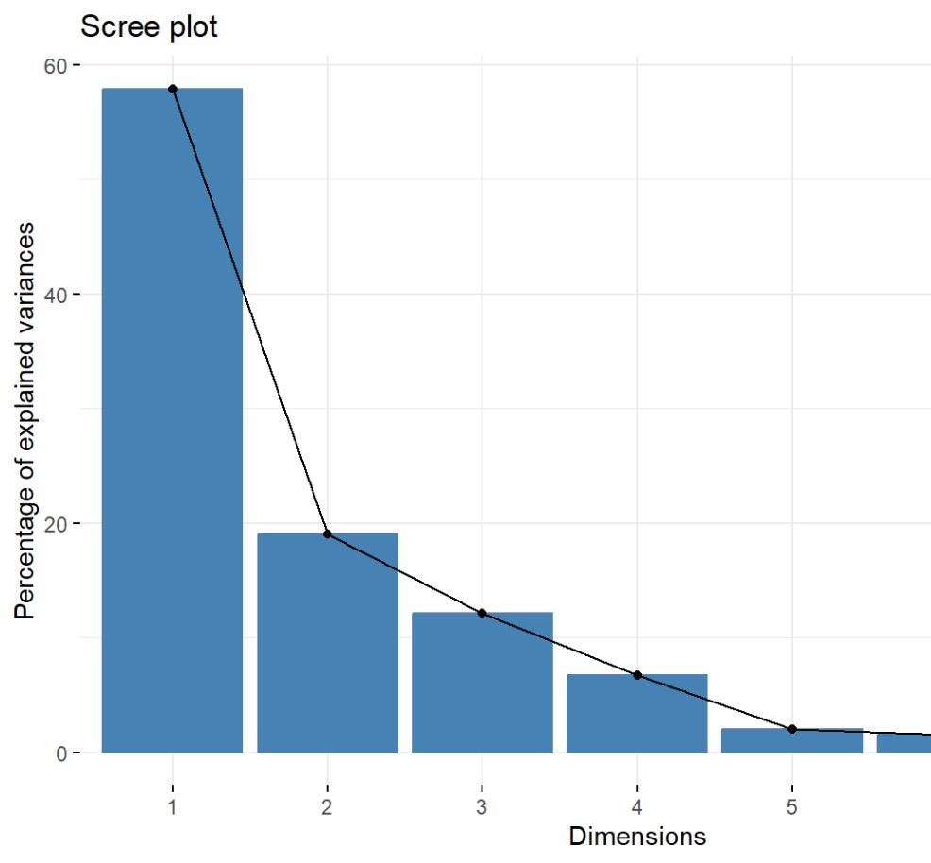
Principle Component Analysis(PCA)
Creating dummy variables and performed PCA on the dummy variables.
Plotted SCREE PLOT using function(fviz_eig)

Slide 11
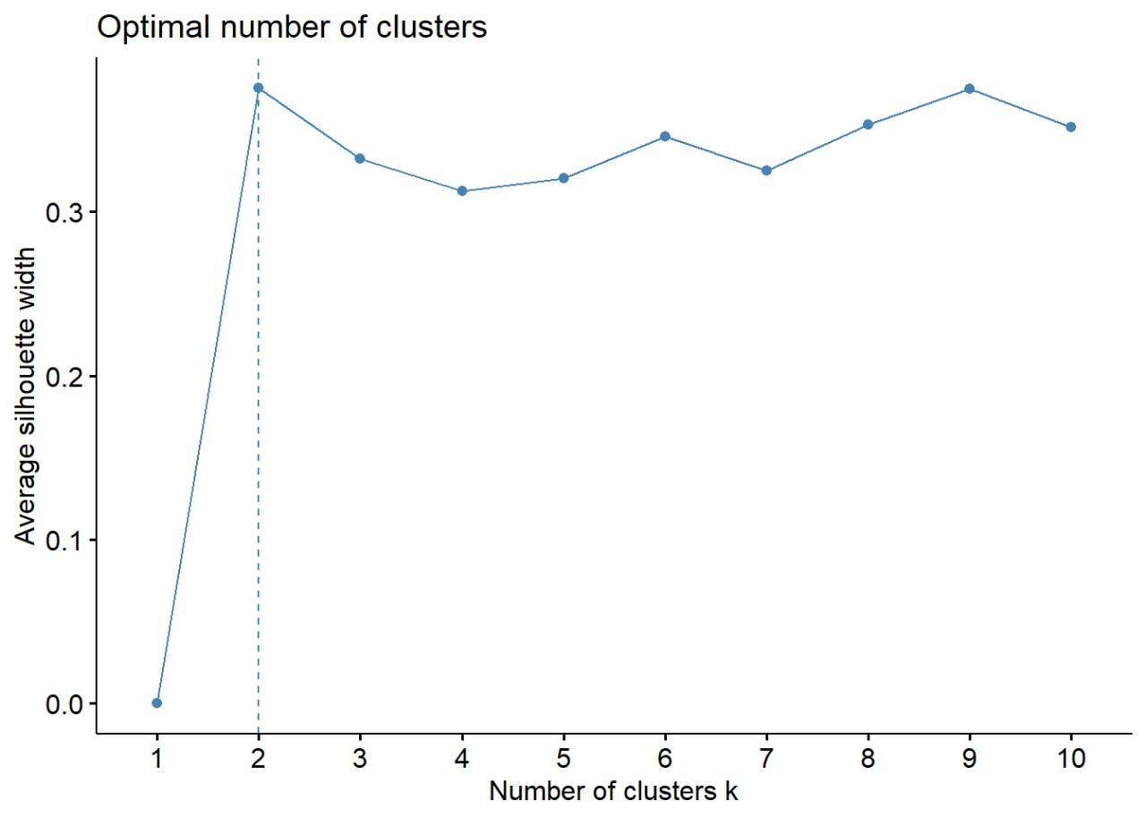
SILHOUTTE METHOD
In this method by using fviz_nbclust the optimal number of clusters are found.

Slide 12
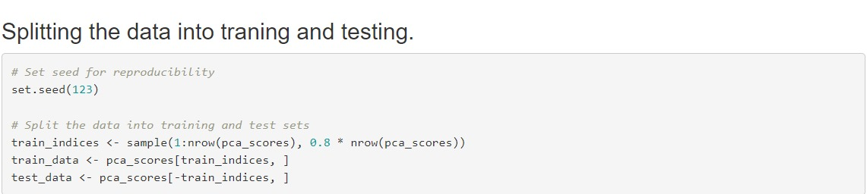
DATA PARTITION
Data was partitioned into training and testing with 80% into training and 20% into testing.

Slide 13

MODEL SELECTION
K-Means
DbScan

Slide 14
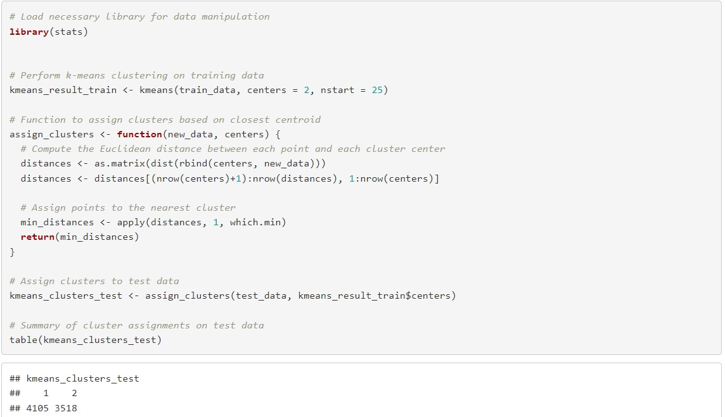
K-Means
Performing k-means clustering on training data using 2 clusters.
Assigning clusters to the test data based on the centroids obtained from the training data and it summarizes the cluster for the test data.

Slide 15
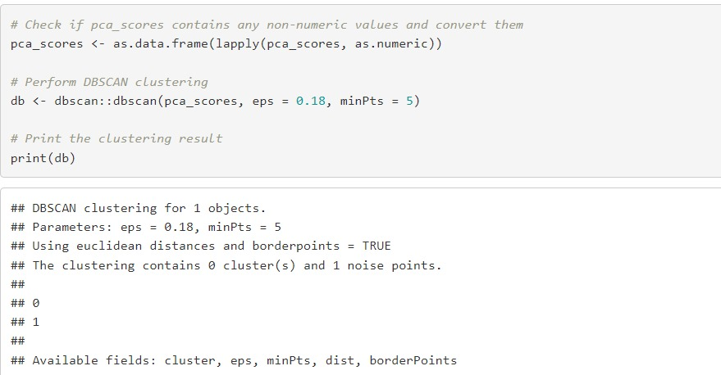
DBSCAN
Performs dbscan clustering on pre-processed data and prints the clustering results.

Slide 16

CONCLUSION
Both the K-Means and DBSCAN models proved effective in clustering the dataset for vehicle fuel consumption during the analysis.

